Slide 1


Airline Product Defintion and Taxonomy BRD Chapter 4.2 Overview
Airline Product Management Working Group
01/09/2025
Gregor Baues – Air France/KLM

Slide 2
Product INFORMATION Exchange Business Architecture Requirements Layered Architecture
Product Business Schema: serves as a specialized framework, allowing for effective organization and management of products within specific classes like e.g. Transport, …
2
Product Definition: serves as an abstract model that encapsulates any product type, allowing for versatile applications across various industries and markets. Key for successful standardization of a flexible and extensible Product Information Exchange
1
Core of the Airline Product Definition and Taxonomy BRD
Operational Product:
offered to the customer with all
delivery and pricing information
included (not in the scope of the Product Information Exchange)
4
Concrete Products: This layer re- presents a tangible retailing view of a product, showcasing how previous layers materialize, using real-world retailing values
3
Notes:
Layer 1 This foundational layer establishes the basis for subsequent product development, aiding teams in conceptualizing and aligning their visions, ensuring clarity before delving into specific product classes.
Layer 2 This layer tailors the generic product model to a specific product class by defining the common features all products in that class share. It also specifies the concrete characteristics of those features, such as the possible reference systems used to describe values. For example, the Transport Product Schema is defined here, capturing the shared features of flights, trains, buses, and other transport products.

Slide 3
Product INFORMATION Exchange Business Architecture Requirements Layered Architecture
Product Business Schema: Build from (1) e.g. Transport, Baggage, Meal etc ..
2
Product Definition: Core assets: Products , Features, Rules, Reference Systems etc..
1
Core of the Airline Product Definition and Taxonomy BRD
Operational Product:
AF001-CDG-JFK/05/11/2025:10:30CET
NS24567/06/12/2025:14:32CET (not in the scope of the Product Information Exchange)
4
Concrete Products: Build from (2) e.g.
Flight transport CDG – JFK, Train from
Schiphol to Amsterdam Centraal
augmented by Taxonomy
3
Notes:
Layer 1 This foundational layer establishes the basis for subsequent product development, aiding teams in conceptualizing and aligning their visions, ensuring clarity before delving into specific product classes.
Layer 2 This layer tailors the generic product model to a specific product class by defining the common features all products in that class share. It also specifies the concrete characteristics of those features, such as the possible reference systems used to describe values. For example, the Transport Product Schema is defined here, capturing the shared features of flights, trains, buses, and other transport products.

Slide 4




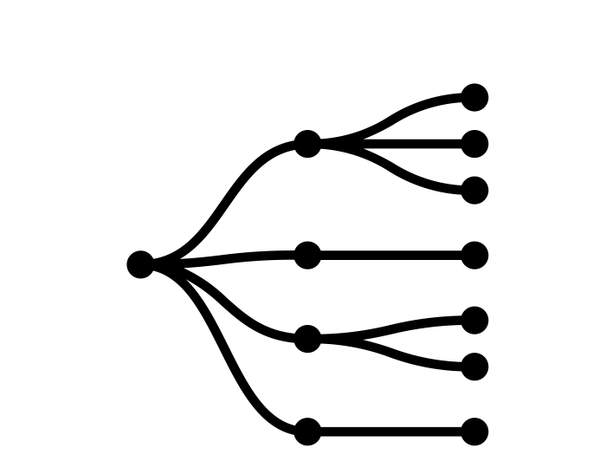
1
Product Information Exchange Product Definition – Business Concepts
As a retailer, supplier or seller we need a semantically clearly defined and unambiguous language to describe what products under which conditions can be sold in the global ecosystem. This has the highest degree of standardization. Everything else is derived from here which is key for enabling extensibility and flexibility at all times.
Product: Represents the central business entity, capturing the scope and management of the entity. It is an abstract, schema-level construct that can be specialised into concrete product schemas. A product aggregates features, is subject to rules, and can be classified against taxonomy concepts.
Feature: Defines a characteristic or property of a product. Features are flexible in structure, with values expressed as single values, ranges, discrete sets, or references to external systems. They provide the building blocks to describe products consistently across domains.
Rules: Encapsulate business or operational constraints that govern how products and their features can be defined, combined, or offered. Rules ensure compliance with commercial logic, technical feasibility, or regulatory requirements.
Feature Value Reference System: Provides the contextual framework for interpreting feature values. It defines the authoritative set of codes, identifiers, or measurement systems (e.g., IATA airport codes, ISO currency codes) against which product features are validated and understood.
Taxonomy: Represents a semantic term within a controlled vocabulary or classification scheme. Taxonomy concepts enable consistent tagging and grouping of products and features, allowing navigation, filtering, and alignment with business hierarchies.
Core Assets
All linked together
Notes:
Core concepts
Product
Feature
Reference systems
Rules
Taxonomy
And its actually enough for the standard not withstanding the way the information encoded by the schemas derived from above will be transmitted.
Don’t send me anything I don’t need in order to execute any action on any of the core assets ( -> minimize data exchange volumes – letter sizes are determined dynamically just like in retailing where box sizes are determined based on the order )

Slide 5
2
Product management Information Business Product SCHEMA
We define some Business Product Schemas build upon all the elements from the previous slide. This layer specializes the generic model for a specific class of products. It defines the common features shared by all products of the same class.
Name
Departure Station
Type
Transport
Arrival Station
…
Features
Distance
…
Generic Rules
Valid for all Transport products
IATA Stations
UIC Stations
Generic Taxonomy Tags
Valid for all Transport products
Reference
Core Assets
All linked together
ISO 80000 Metric
…

Slide 6
3
Product management Information Concrete Product
Transport product
CDG – YUL use the features from the 124 ticket

Slide 7
4
Product management Information Rules
Illustrate a rule on the product
CDG – YUL ( channel etc. … ) illustrating the supplier's point of view to be considered by a retailer in order to know if he can reasonable y ask for that product with a high degree of probability to obtain a positive answers.
Remark: The only leftover uncertainty should be the availability of the product ( i.e. stock ) as this is not communicated by a supplier to a retailer in all cases.

Slide 8
5
Product management Information Taxonomy

Slide 9
2
Product management Information Business Product SCHEMA
We define some Business Product Schemas build upon all the elements from the previous slide. This layer specializes the generic model for a specific class of products. It defines the common features shared by all products of the same class.
Disclaimer :
This is a ’proposal’ ready to use by two partners, but they could decide to do whatever they like based upon the previous layer, without requiring any interactions with the standardization body
APMWG creates ready-to-use schemas shared between partners, enabling a common understanding of the concrete products ( cf. next slide )
Concrete products are always derived ( not specialized as before ) from a business product schema
Core Assets
All linked together

Slide 10

1
Product Information Exchange Product Definition – Business Concepts
As a retailer, supplier or seller we need a semantically clearly defined and unambiguous
language in order to describe what products under which conditions can be sold in the
overall
Products core
Notes:
Core concepts
Product
Feature
Reference systems
Rules
Taxonomy

Slide 11
Product management Information Architecture
Layer | Description | Remark
Layer 1 - Product Definiton | This is the most abstract layer. It defines the core concept of a "product" in a generic way, capable of representing anything from a physical good to a service. Its attributes are intentionally broad. | As this layer is abstract there is no concrete implementation for this layer but its required to construct semantically sound Product Business Schemas
Layer 2 - Product Business Schema | This layer specializes the generic model for a specific class of products. It defines the common features shared by all products of the same class. For the common features a set of concrete characteristics will be defined here. e.g. possible reference systems to choose from for desribing values of a feature. The concrete choice is done in the level below | E.g The Transport Product Schema representing the class of all sorts of transport products is done on this layer. It defines the common features shared by all transport products, whether they are flights, trains, or buses etc…
Layer 3 - Concrete Product | This is a specific, tangible instance of a Product Business Schema. It has concrete values for all the features defined in the layers above. This is the actual product a customer would purchase from an retailing point of view. It represents a concrete but non-operational product definition. It defines the "what". Note: There is an additional Layer we do not further elaborate on as it involves the Offer step where the above product becomes 'sellable' i.e. represents the product offering. An offering references a concrete product and adds the specific operational and commercial details, such as date, time, price, and availability. It defines the "when" and "how much". There can be many offerings for a single concrete product. This is not in the scope of this document/section | This is a specific, tangible instance of the Transport Product Schema. It has concrete values for all the fields defined in the layers above. This is the actual product a customer would purchase. Considering e.g. a flight from CDG to AMS this is the flight route itself, which exists independently of any specific date or time.

